Slide 1


Tableau Public: An Introduction
Data-Driven Scholarship Institute
Hong Kong University
Nicholas Weber

Slide 2
This session: Soup to Nuts!
Overview
Connect to data
Data Preparation
Creating a Chart (Wizard + ‘show me’ toolbar)
Publish a visualization

Slide 3

Tableau Public
Free and open-access data visualization platform
Widnows, Mac, and Linux versions
Manipulate and pre-process data for visualization
Create Dashboards and ‘Stories’
Publish visualizations on the web

Slide 4
Overview
Load Data (simple as drag and drop)
Locate the file: World Bank Co2 Cleaned
Data Viewer (quick check of variable names, etc)
Sheets
Simple drag and drop
Start with Dimmensions-> Country Name. – Gives us a world map.
Next add CO2 emissions – see bubble sizes adjust
How about another encoding? Drag CO2 to the ‘Marks’ space
Edit colors – we can differentiate the variable’s color
Notes:
Who are biggest polluters and what is their climate impact?

Slide 5
Overview
Sheet 2 -
Let’s create another ’view’ of that data
Double click – CO2 Emissions
Dimensions – give us more insight.
’Year’
‘Countries’ – notice trends in the data.
Remember our last sheet – we used a color encoding.
Create the same color scheme for this chart.
Name our sheets – so we don’t confuse them.

Slide 6
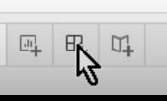
Overview
Dashboard
Combine our sheets (charts) into a new dashboard.
Click the icon in middle of screen
Our sheets are in left column
Drag and drop sheets onto canvas
Arrange them by dragging around the canvas
Adjust size (things to consider: Where will these be published or viewed?)
Adjust the ‘legends’ (remove)

Slide 7
Overview
Dashboard interaction
Now try to relate the visualizations to one another to make them interactive – use the ‘Filter’ button on our World Map
Now click a country. We should see the corresponding data ‘isolated’ in the second visualization
Objects – we can supplement our visualization with information like a title.
We can rearrange the elements before publication.

Slide 8
So Easy!!!! Now - let’s go slower and explore each step.

Slide 9
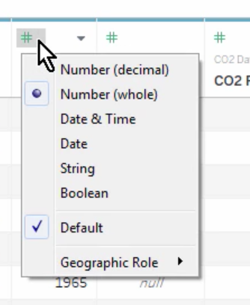
Connect to Data
Connect to data
We don’t actually ‘change’ the underlying data.
Types of files we can connect to?
Excel, CSV, Stats (SPSS), Google Sheets, AND MORE
Connect to data…
We see file listing.
Preview. – limited to 1sheet, and 1000 fields.
Symbols – tell us what kind of data each column contains. What if this is wrong? We can change symbols by clicking and selecting another type.
Dynamic Data (Google Docs)– More at the end.

Slide 10
Load a dataset
On your terminal find dataset named ‘World Bank CO2 cleaned’
Open the file in Excel first....

Slide 11
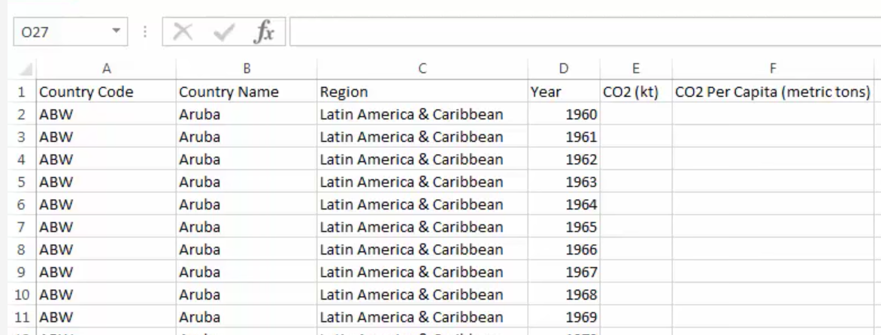
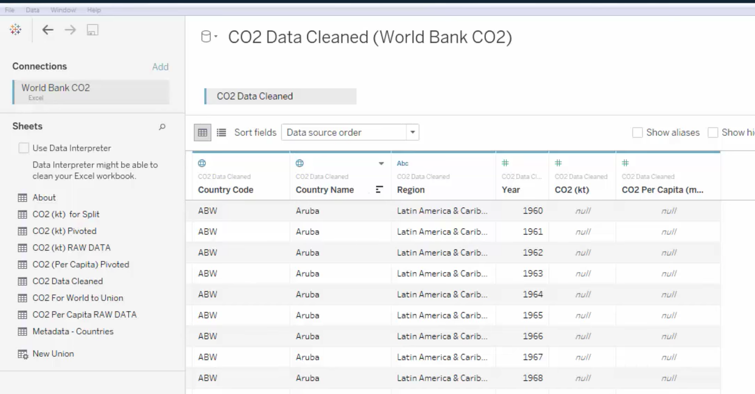
Data Preparation
Notes:
Now lets load the excel file into Tableau … (Demonstrate on screen)
Ideal data – 1 column for 1 variable. 1 data point for one cell … Make sure that we are looking at the data source view... Now lets look at the sheets view....

Slide 12
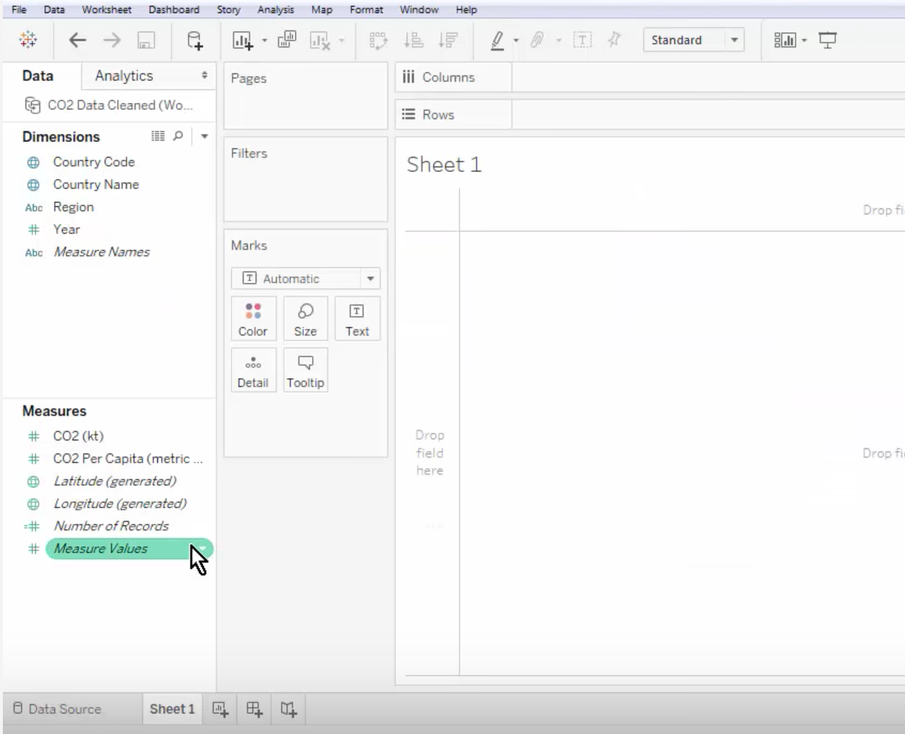
Data preparation
Notes:
Make certain that our variable names (dimmensions and measures in this case) are clearly translated into the sheets view

Slide 13
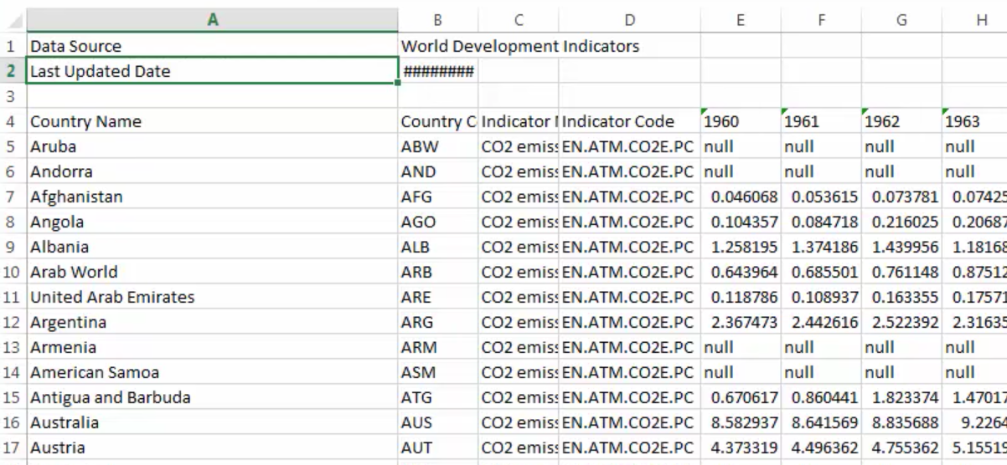
Not so fast
Most data are not this clean … how much preparation work should we do before importing to Tableau Public?

Slide 14
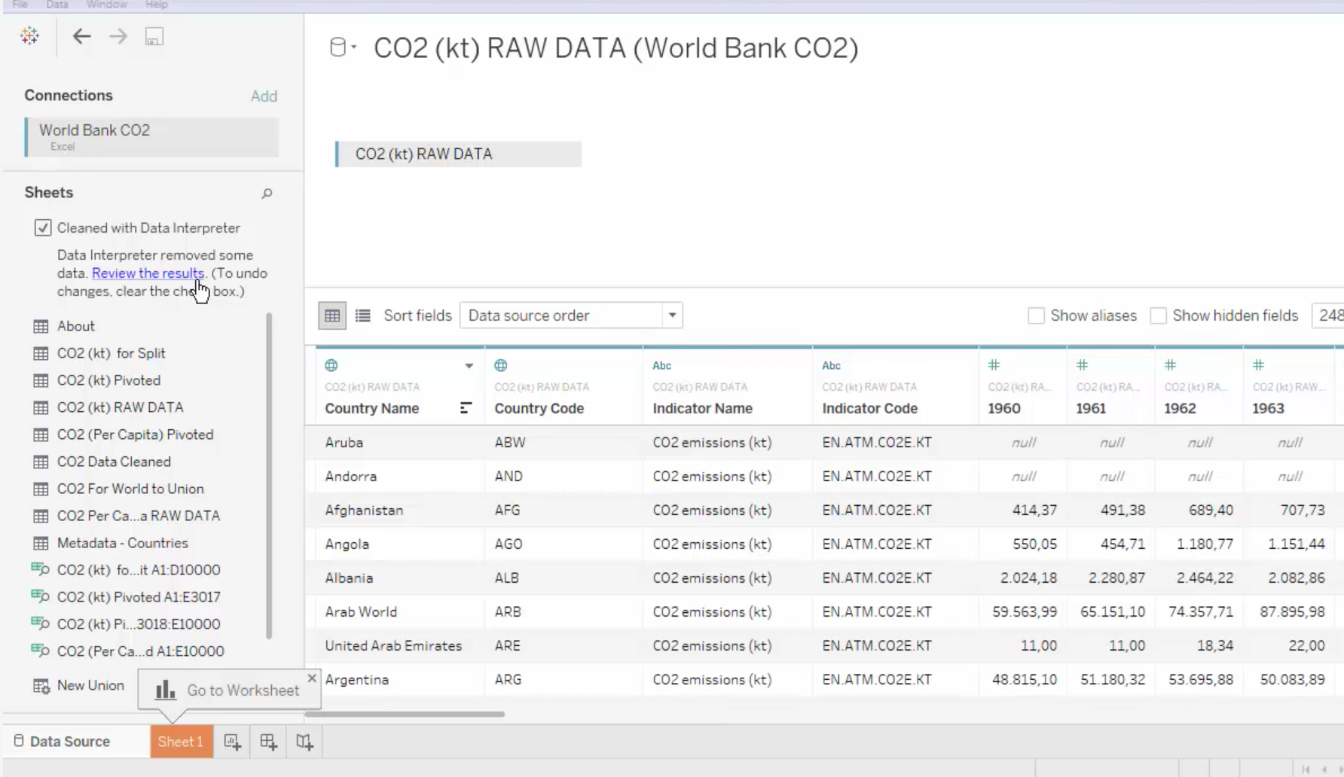
Data interpreter … automatically transforms data...
- Load a new dataset – ‘C02-RawData’

Slide 15
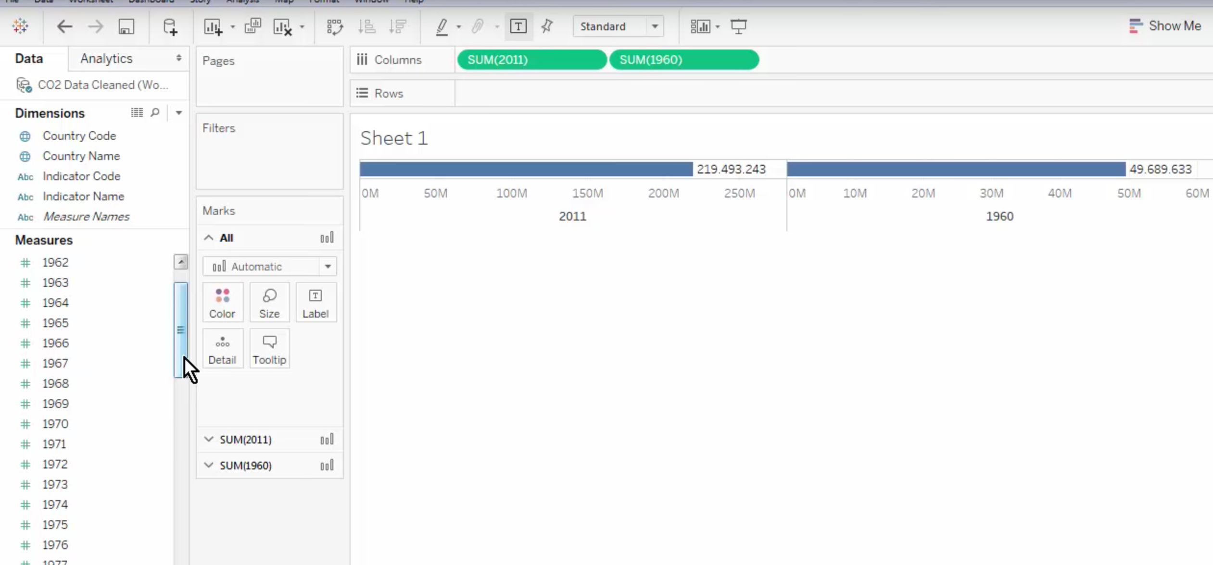
Pivot Data
The new ‘raw data’ aren’t summarized for us.
Columns correspond simply to years of emissions… this limits our ability to create broad visualizations... Like emissions across all years

Slide 16
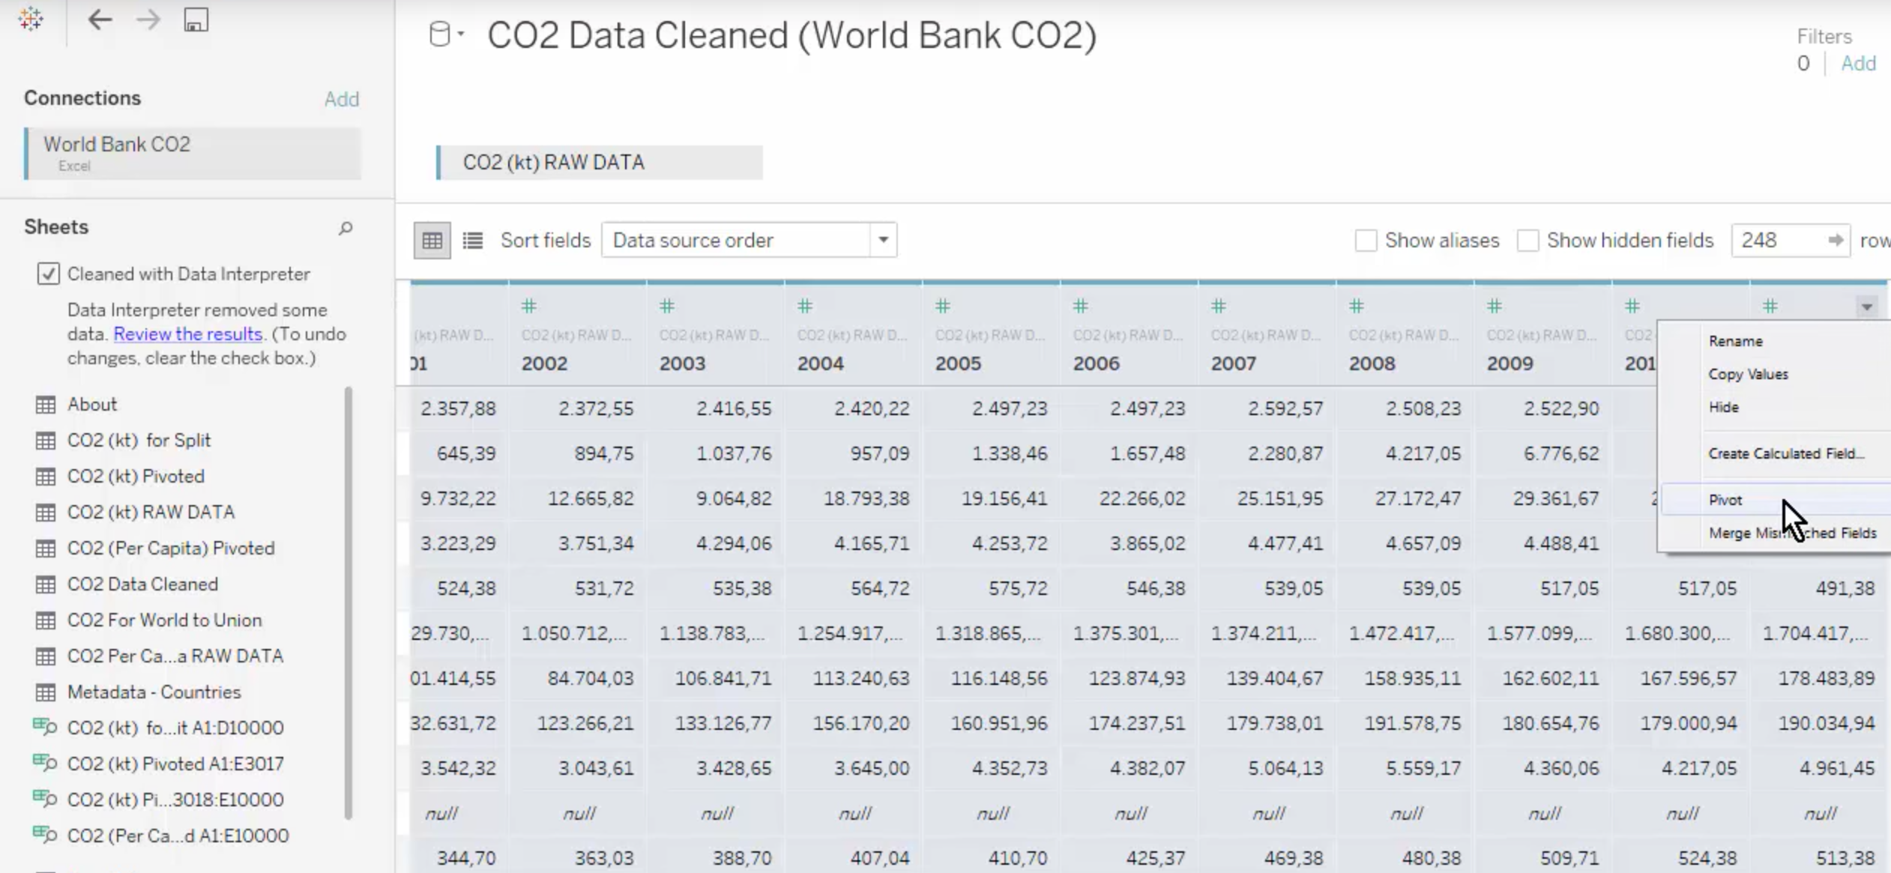
Pivot data…
Transform ‘wide’ format, to ‘long’ format…
We want to transform the columns into rows – so that we have two variables...Years and Emissions for each country
Tableau makes this simple – just select all columns that we want to transform (drag your cursor) and select ‘Pivot’

Slide 17
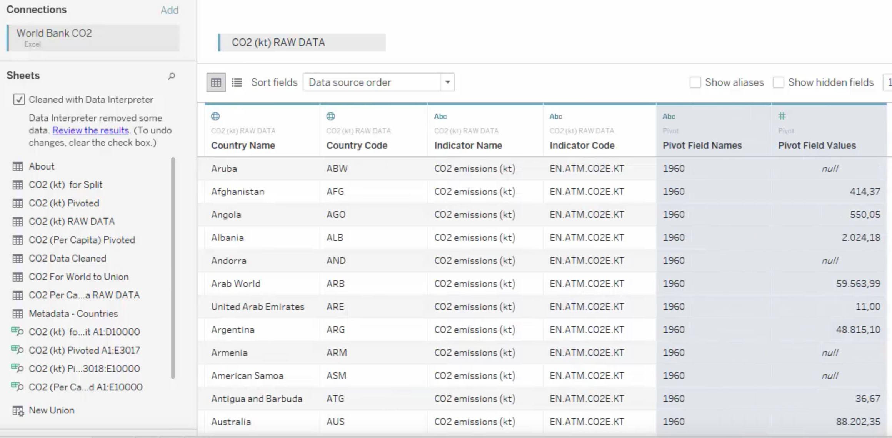
Pivot data…
Notes:
Now for each country we have a year of emissions data, and the measurement of the emission… notice we have less columns,,,, but many more rows,,,, since we transformed the columns to individual data points...
Let’s rename the new variables... The first is Year... The second is CO2

Slide 18
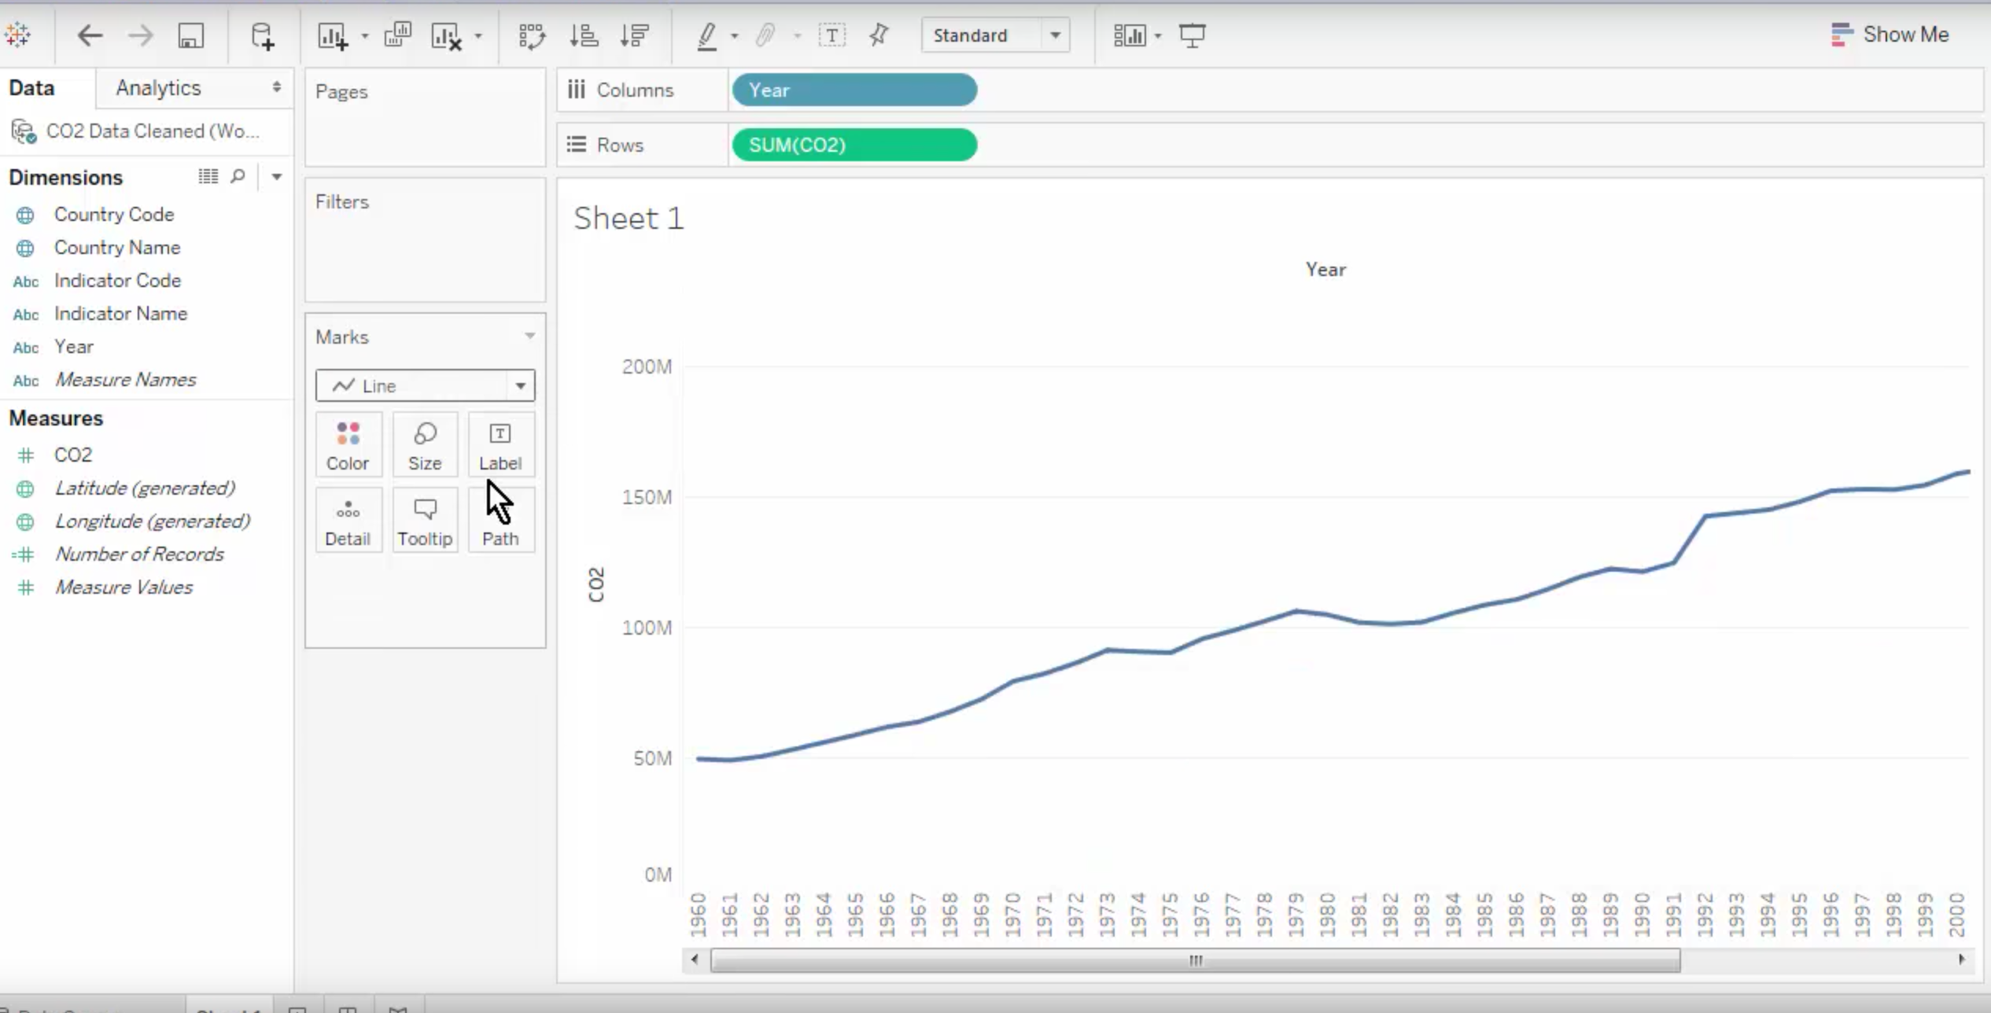
Pivot data…
Notes:
Now that we have summary statistics for each country… we can easily create a line chart which shows the amount of CO2 emissions by year...
Drag the Year to our column, an the Summary to our Rows... And then transform the marks from Bar to Line... And Voila – we have a line chart summarizing our very complex data!

Slide 19
Splitting your data…
In the previous example we wanted to create summary visualizations – and needed to condense our data from columns to rows…
But sometimes we want to do the opposite – make even more columns so that we can create more specific visualizations... (e.g. Names – we might want to split first and last names)
Load the dataset labeled ‘CO2 RAW Data’
We see the first variable has values that are Country and Abbreviation
Click split – and the algorithm will chose a split for us, and create two new columns

Slide 20
Splitting your data…
What if we want to control the split?
Select the column- and choose custom split
Notes:
Now we can choose how we would like to split the data… if we choose to create just 1 new column,,, our original data will remain intact, but a new column, with just the abbreviations will be created.... And we can get even more specific... If we want to control how the split is performed we can select the column, and choose ‘Edit” – this will allows us to manipulate the string formula... We can then specify which column is split, how, etc. ... Remember to rename your new columns....

Slide 21
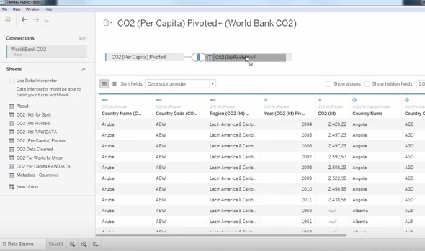
Joins and Unions…
Using data from two different datasets
Two options
Joins – combine the columns of two datasets
Unions – merge the rows of two datasets
For example – what if we had received the CO2 per country, and the CO2 per capita datasets separately? – Drag and Drop!
Notes:
By dragging and dropping the datasaets next to each other in the data interpreter Tableau Public will place the columns from each dataset lined up next to each other…

Slide 22
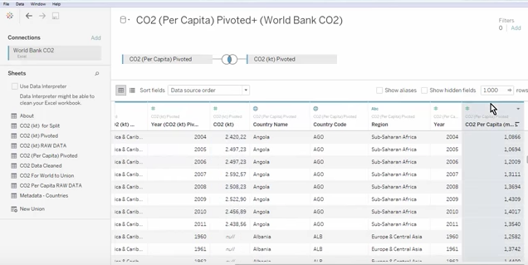
Joins
We now have CO2 and CO2 per capita in the same dataset
Notes:
This is an example of a Join! – we have the two variables from different datasets together … notice that in combining ALL of the columns from each dataset... We also have some duplicates, such as country, and country code... So we can hide, or delete these columns so that we don’t get confused in creating a chart...

Slide 23
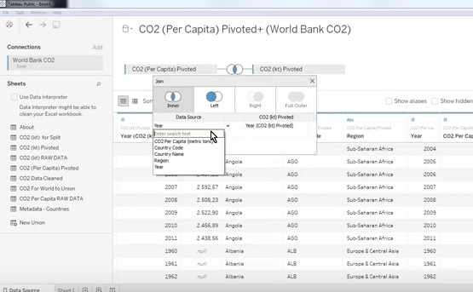
Joins
If we want to control the columns that are added in a join… we click the symbol between our dataset names and can select from a dropdown menu
Notes:
For example… if we wanted to just join all of the data that the two datasets share in common... We could select the Join symbol... If we wanted to make sure that we only retained all of the data from the first dataset, and only added what was new from the second dataset. We could select LEFT join... Becuase the first dataset is on the LEFT side...

Slide 24
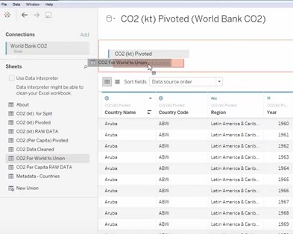
Unions
Merge different rows from matching columns (we are STACKING data rows for datasets that have the same columns)
This is helpful when we gather more data – we can simply add new data by adding more rows…
Notes:
Note to move our datasets from the Join example… we simply select the dasets and drag them to the blank space beneath our workbook...
So lets now select the dataset that says ‘CO2 Pivoted’ and the dataset that has all global emissions – called CO2 for World to union .... To do this simply add one to the data interpreter... And then drag the next directly under it until we see the orange box appear...

Slide 25
Unions
Now we have all country C02 emissions – at the top of our single dataset, and the WORLD CO2 emissions at the bottom
If we try to make a Union with two datasets that have different column names….Tableau Public will create two different fields… but we can go into the column name, and select “Merge Mismatched Fields” and this will allow us to combine two columns with different names (but the same data)
Note also that Tableau Public creates a new set of columns telling us where the original data came from ...
Notes:
Scroll to the bottom of the dataset… we have now combine all rows from the two datasets... Which include individual countries, as well as the world...

Slide 26
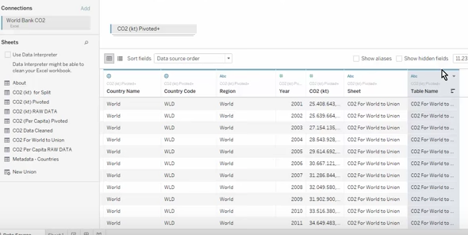
Unions
Notes:
This is very handy if we are combining many datasets, and need to keep track of where data were added from…

Slide 27
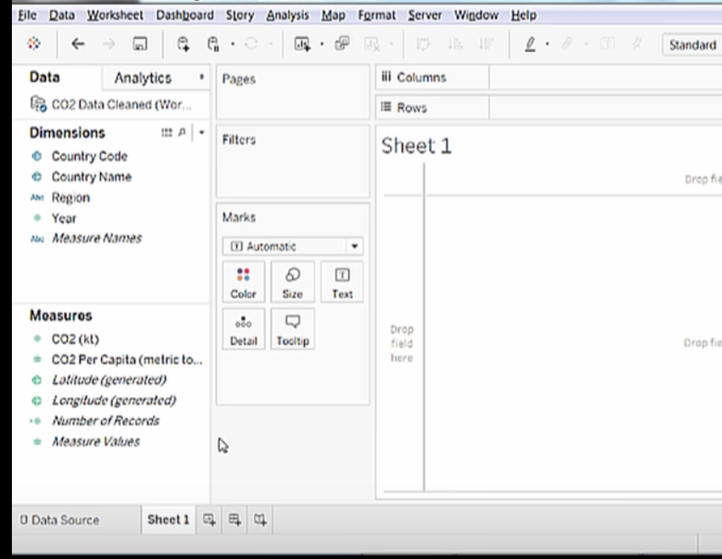
Making Charts
Fields: Dimensions and Measures on left hand panel.
Load data ‘World Bank CO2’
Click on ‘Sheets 1’

Slide 28
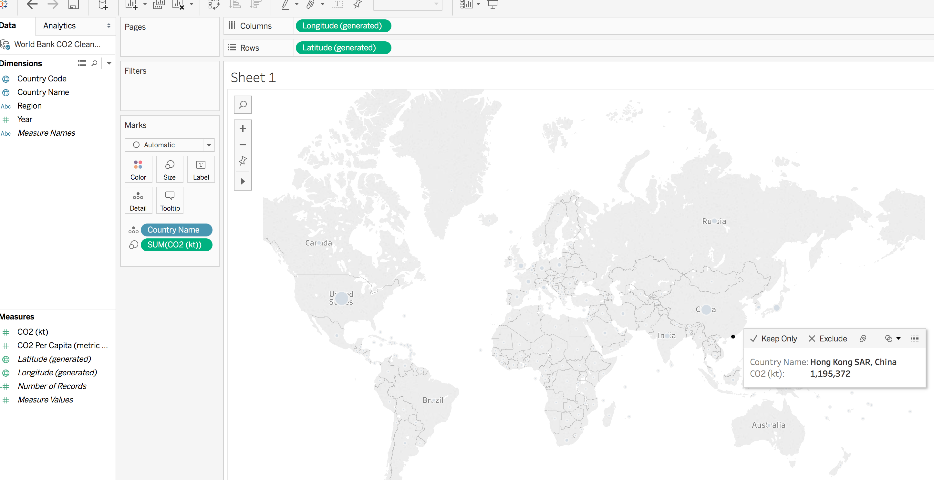
Making Charts
Double click on Dimension - ‘Country Name’ - this displays all countries in our dataset
Double click on Measures ‘CO2’ – now we have dot sized to how much emissions each country produces
If you hover over each country - we see how much CO2 they have emitted

Slide 29
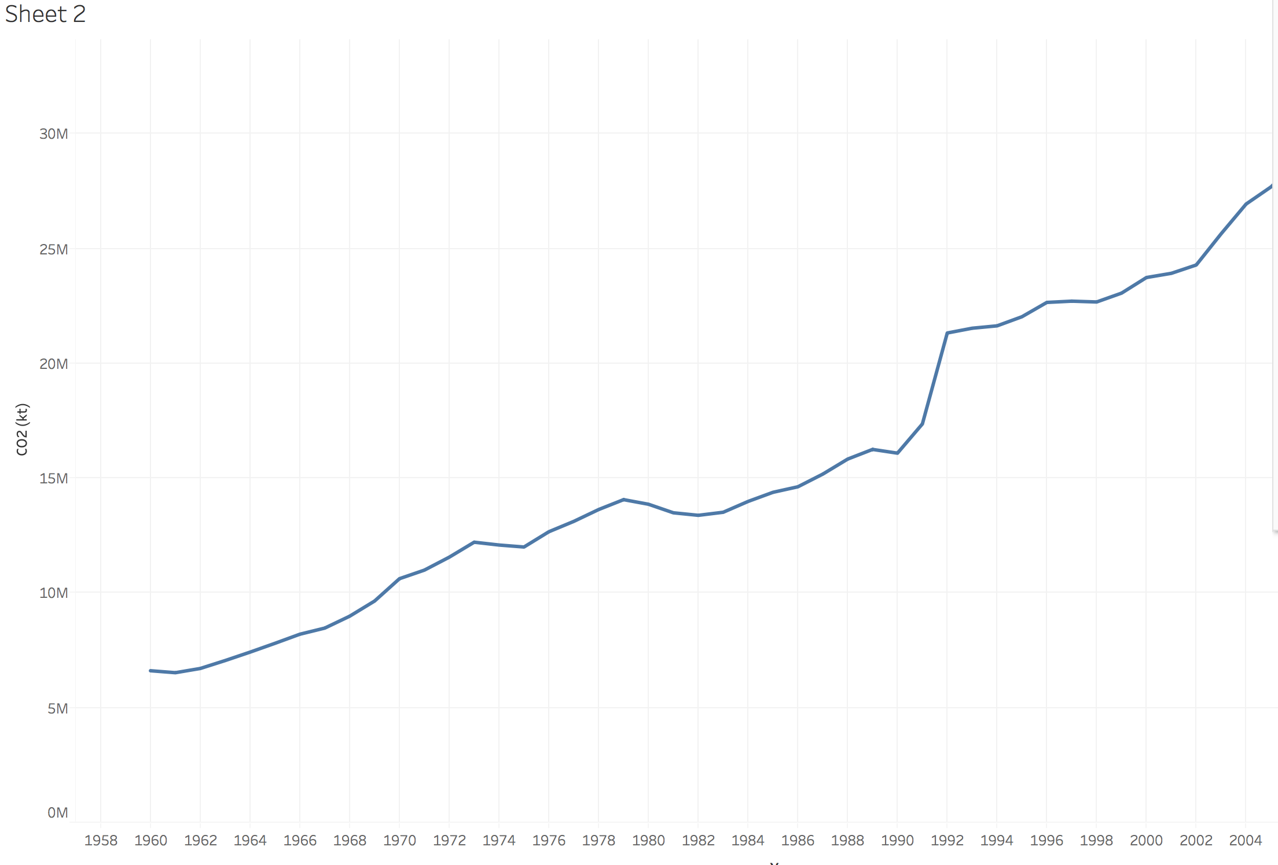
Making Charts
Create another chart – click on lower column icon, and SHEET 2 will appear
Double click Dimenions ‘YEAR’ – we see all years as a horizontal axis
Double click Measure ‘CO2’ –
Line Chart of CO2 over time
Notes:
Let’s try to do something more complex… Let’s try to visualize the evolution of emissions by country for all of the dates that are listed in our dataset... To do this, we first create another sheet. ...
Then we click on YEAR in our

Slide 30
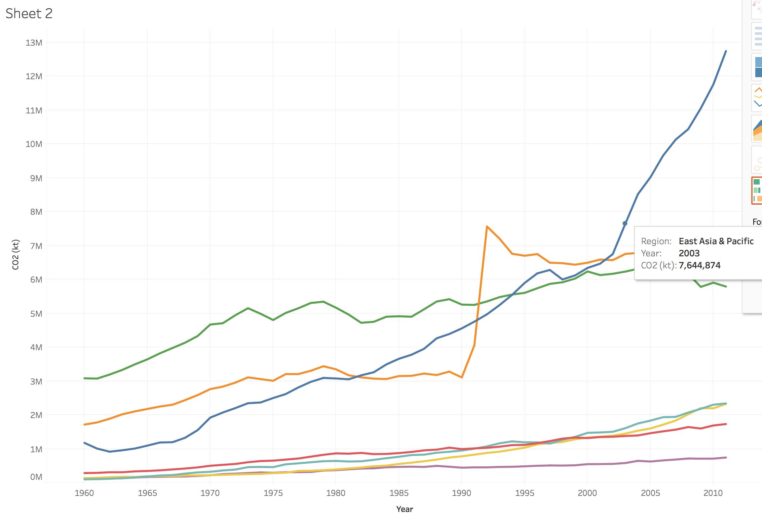
Making Charts
Double click Dimensions ‘Region’

Slide 31
Making Charts – show me toolbar
The ’Show Me’ toolbar makes suggestions about the appropriate charts for your data.
If you select the toolbar – Tableau Public will suggest the types of fields we should click in order to create that chart
If we know which fields we want to use in a chart we can use this tool to see which Chart types are appropriate
Hold down (Ctrl – For Windows) or (Command – For Mac)
Select the fields of interest – Country Name + CO2
In the Show Me toolbar – the appropriate charts are highlighted

Slide 32
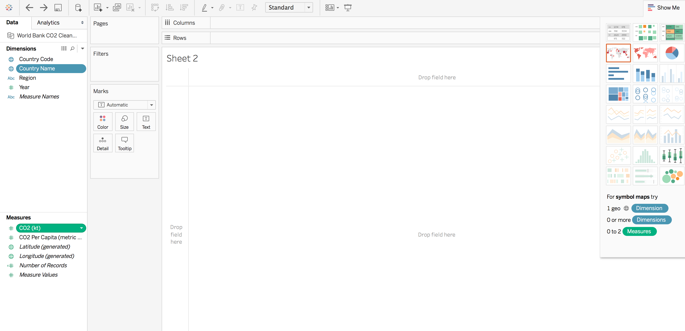
Making Charts – Show Me toolbar
Notes:
Notice that the appropriate charts are highlighted… and the best chart is outlined in RED – if we select this chart we see the same Chart that we created in the last exercise...

Slide 33
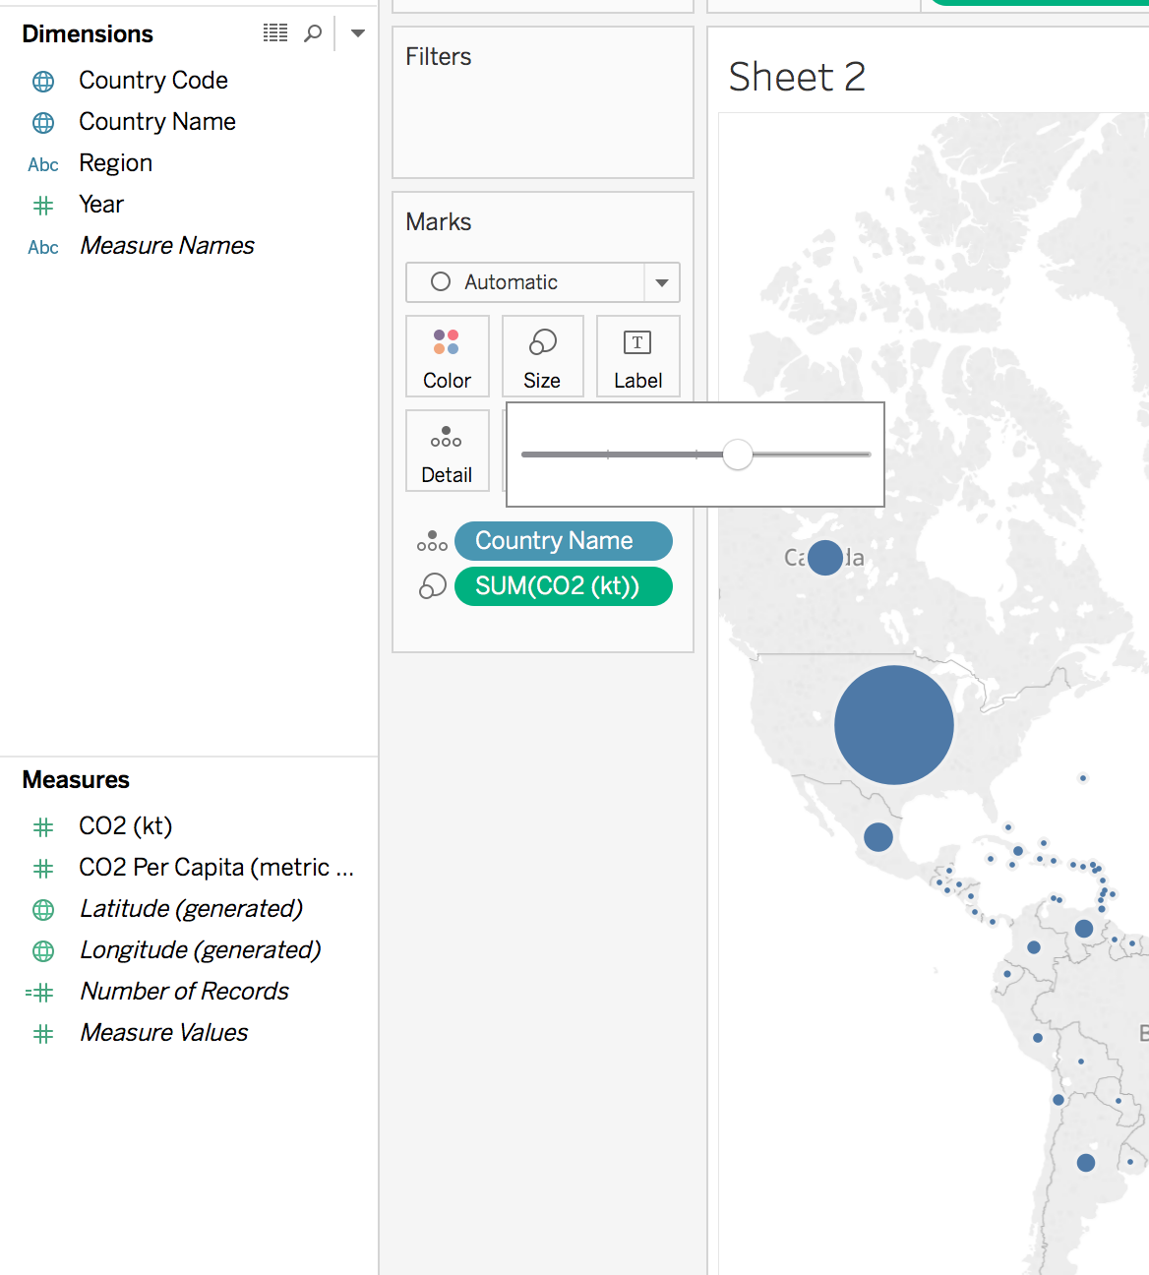
Making Charts - Marks
To change the appearance of our chart we use the MARKS toolbar
We change the bubbles on each country by clicking on SIZE
This change corresponds to :
CO2 is emitted by each country

Slide 34
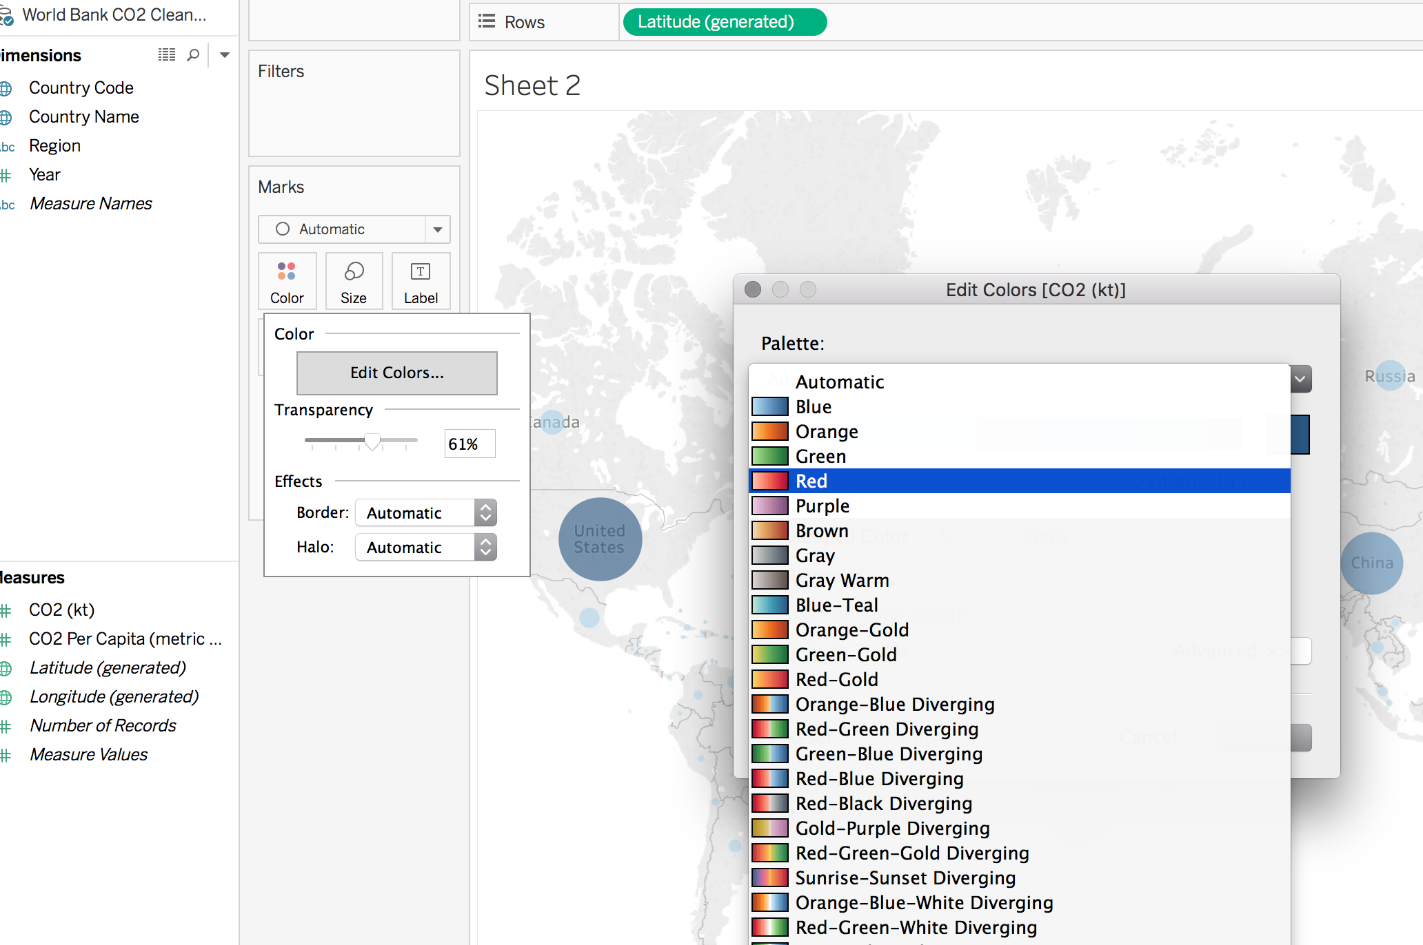
Making Charts - Marks
We can also adjust the color by dragging a field onto the MARKS toolbar COLOR
And opacity…

Slide 35
Making Charts - Advanced
Temporal data are often most meaningful when showing change over time
But we have too many countries in our dataset to show all of this data over time
We could instead create a summary
Select REGION
Select YEAR
Select CO2 Per Capita
Tableau is summarizing our data for us… but what if we want a more even measure than simply the raw count? To change the way that our data is summarized we can click the SUM (CO2 Per Capita) button

Slide 36
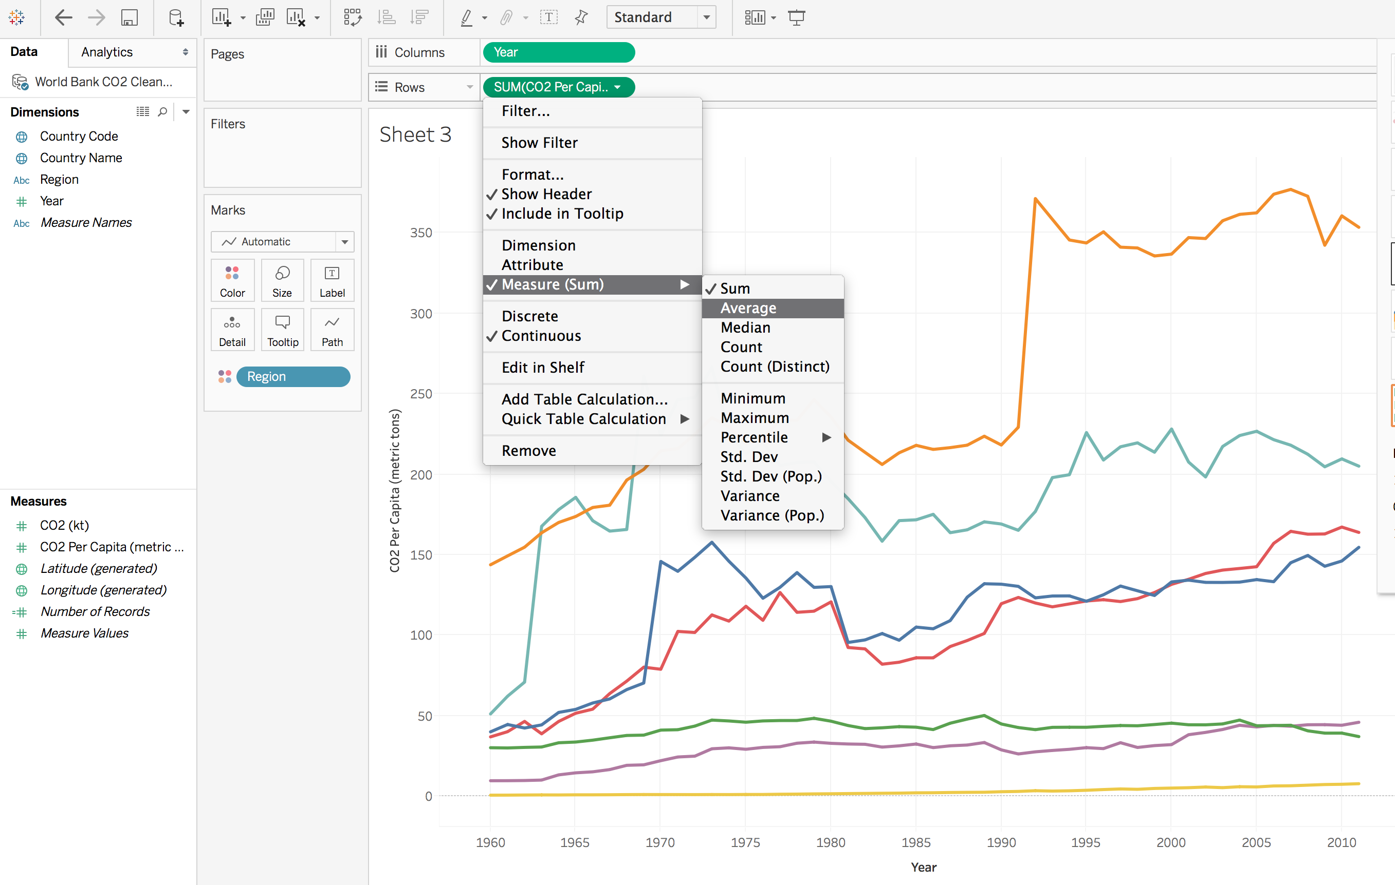
Notes:
Here we can choose how our data are summarized – I think Average is the best measure so I will select that measurement sum ….
Notice that the lines look smoother and more legible... Now we can also add some information for our viewer – Notice that in the MARK viewer we have given the REGIONS a color ... If we also want to give regions a lable we simply DRAG the REGION onto the LABEL on the mark bar– this shows a label at the end of each line....

Slide 37
Publishing a visualization to the WEB
Requires an accout (FREE) on Tableau Public
Click SAVE on the terminal prompt
Sign in

Slide 38
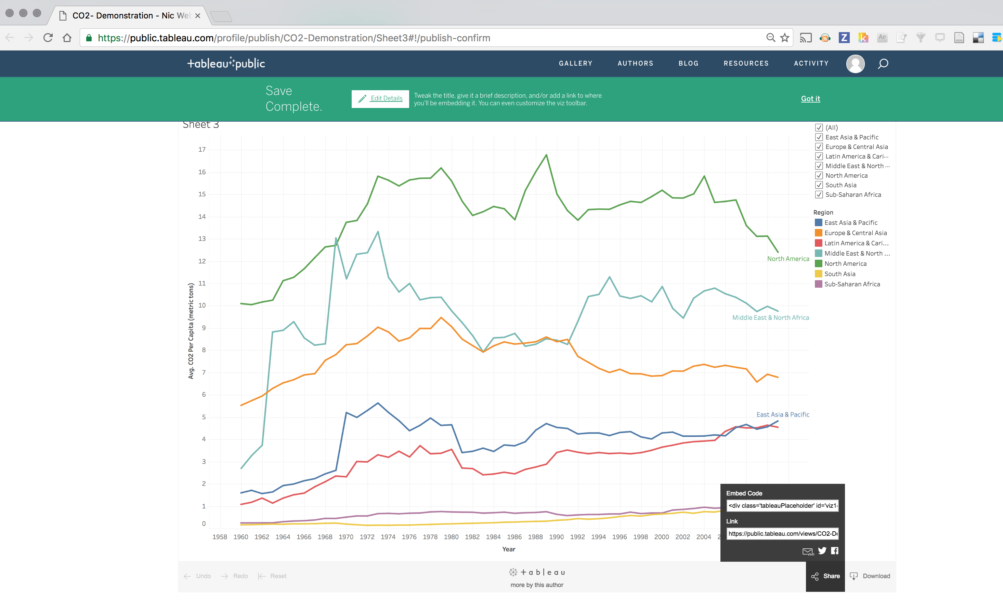
Notes:
Two options – Click share – and you can embed as either a dataframe, or through a link to the chart…
Or you can download an image and post it to your website...

Slide 39
Questions ?

